Slide 1
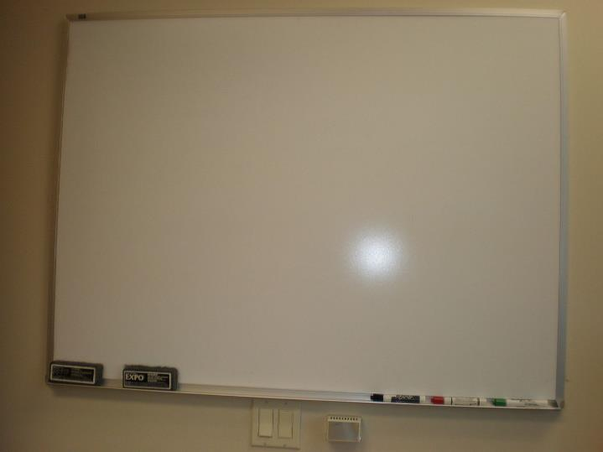
No Whiteboards Allowed

Slide 2


Jessica DeVita
Microsoft
Technology Evangelist
Twitter:
@ubergeekgirl

Slide 3
Notes:
Before joining Microsoft, I had the privilege of consulting for some of the most well known music and entertainment firms and talent since 2005.
I always tried to bring a little devops to all of my projects. But how do you do devops when the CEO won’t allow whiteboards in the office?
You do STEALTH DEVOPS!
But the most important thing I want you to take from this story is that even if you have a LOW OPS environment, to be brave and look at the dysfunctions and risk in your organization, and remove those artificial constraints.

Slide 4
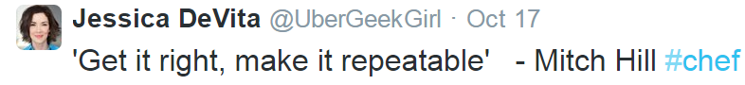

Slide 5
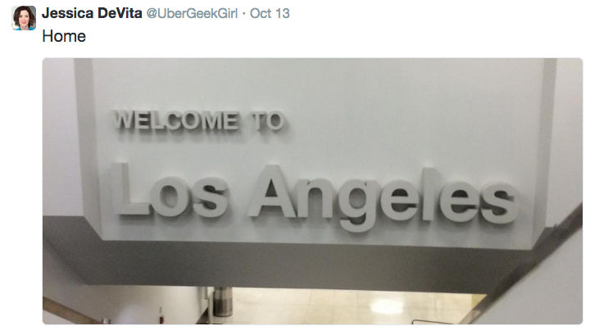
Notes:
I had worked with the CEO on other projects for 6 or 7 years so I knew him pretty well.
He started an advertising company in the 80’s that was extremely successful
By the time he sold the company, the revenue was nearly half a billion dollars annually
New medium in the industry, he sees the parallels to old business model.
But a lot has changed in the app and data economy, with respect to development and operations. The olds ways don’t work.

Slide 6

100m downloads per month of their content
40 employees
$9 million in sales in 2013
$16 million projected for 2014
Notes:
Externally things looked good
But internally they were a hot mess

Slide 7
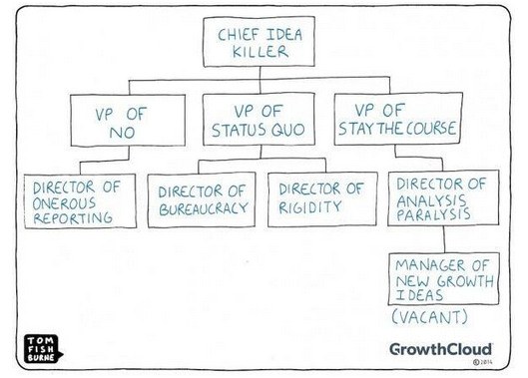
Notes:
With an org structure like this, you can imagine how we were challenged to help this company

Slide 8
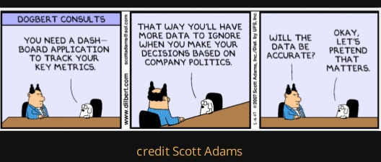
Notes:
His assistant gave me a copy of this 50 page weekly report that he never looks at.

Slide 9

Notes:
Understand the mindset of the CEO
Still on AOL
He doesn’t allow whiteboards
This is not a company that had yet grasped the need to be a technology company that just happens to be in the advertising business.

Slide 10
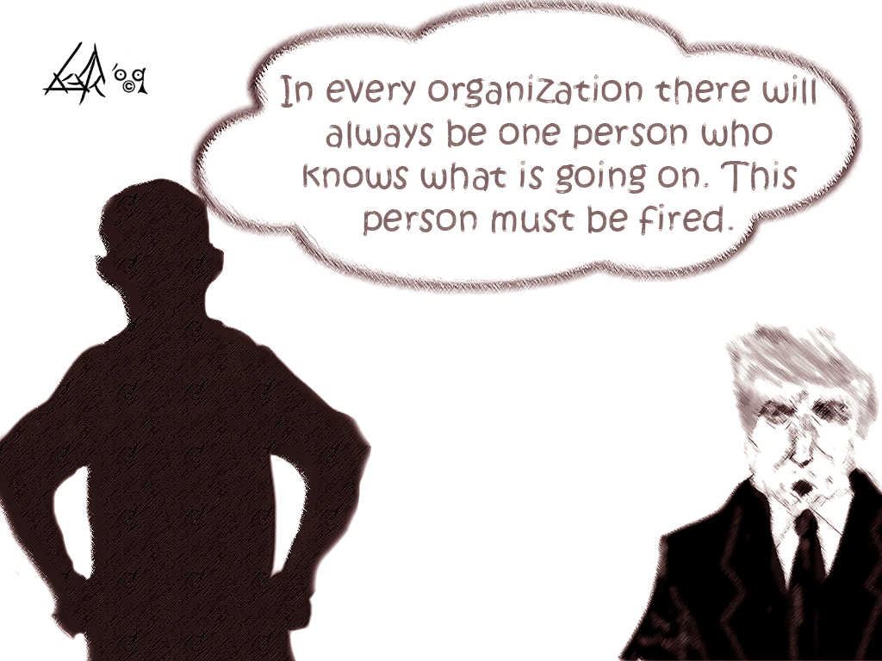
http://upload.wikimedia.org/wikipedia/commons/6/6f/Conway%27s-Law--2.gif
Notes:
How many of you have dealt with “brent” from the phoenix project?
This company had a single tech guy managing everything from printers to email accounts
He also happened to be the only person who could understand the complex vendor relationships and the way their content went from idea through to delivery.
THE CEO DID NOT ALLOW WHITEBOARDS

Slide 11
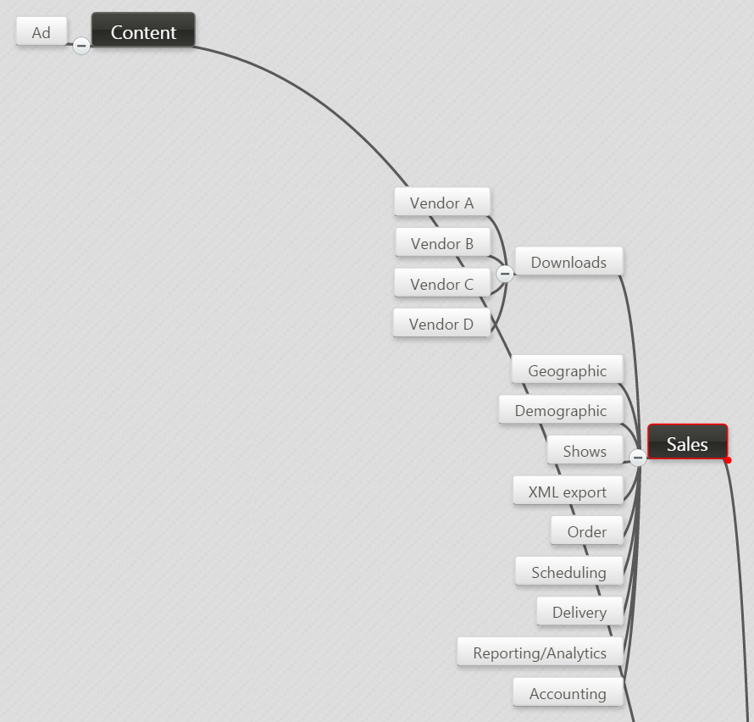
CRITICAL DEPENDENCIES
TRUST
METRICS
Notes:
Looking at the value stream, it became clear that there were critical dependencies that were undocumented and not automated.
The metrics for how you measure reach is still not standardized
When all of these indicators can’t be relied upon, you have some trust issues that you might want to deal with

Slide 12
“Cycle time compression may be the most underestimated force in determining winners and losers in tech.” - Marc Andreessen

Slide 13

Notes:
One big risk we discovered was that they didn’t own their domain name, it was sortof being held hostage by Vendor A. The domain name was valued at over 200k

Slide 14
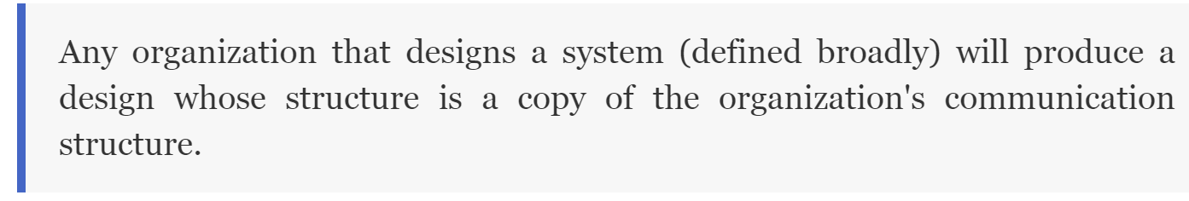
Conway’s Law
Notes:
When I first heard about Conway’s Law I thought that it was referring to this company, surely.
So our first task was a go-no go on further development of a custom application that was designed to manage the business from end to end. They’d actually been sold an ugly access database that could never pass user testing, had 4 pages of bugs and unresolved errors.
We killed that project and instead chose a package that had been in use in the prior company. The team all knew the software and it needed very little customization. But like any 20 year old piece of software, it was monolithic and complex, reflecting the organization in it’s own complexity.

Slide 15
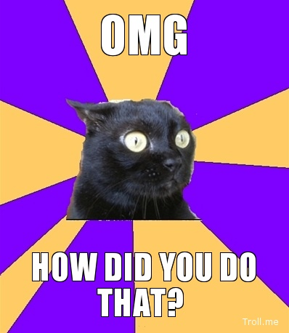
3 million lines of code
Pervasive SQL database
Azure
Server 2012 R2
RDS
Notes:
In spite of their unwieldiness, they know this company and the product, there was a preexisting trusted relationship.
I have to tell you funny story. So after the implementation and once in production, the vendor took me out to lunch and said “how did you put our software in the cloud?”

Slide 16
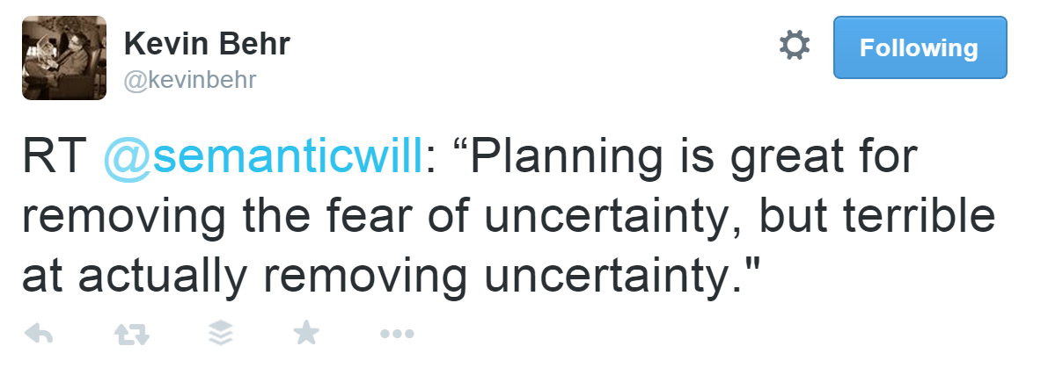
Notes:
We’d have planning meetings, all ostensibly to manage the risks in the business, but no amount of planning can retroactively fix the broken processes and prior bad acts.

Slide 17
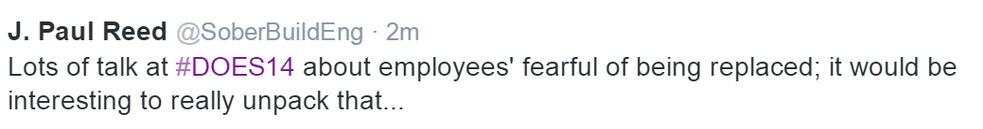
Notes:
By asking Brent to document, he felt threatened.
He became coarse and nervous, openly expressing his unhappiness

Slide 18

(B**tard Operator From Hell)
Notes:
And that is how we end up with BOFH
So what happened?
just didn’t show up for work one morning and said he wouldn’t be coming back.
At that point, we had done as much mitigation as was ever going to get done. Frankly this result wasn’t the one we had hoped for, but in retrospect the incredible tension was just gone when he left. It was the worst and the best thing that could have happened.

Slide 19
“I’ve been in situations where I’ve observed leadership teams locked in chronic underperformance and strife, because of the utter inability for the team members to trust each other.”
-Gene Kim itrevolution.com

